Slide 1
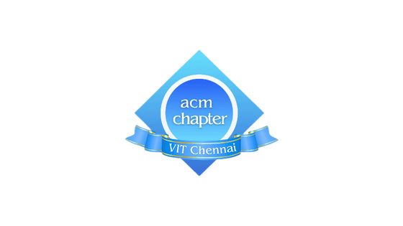


Machine Learning
Day 1

Slide 2
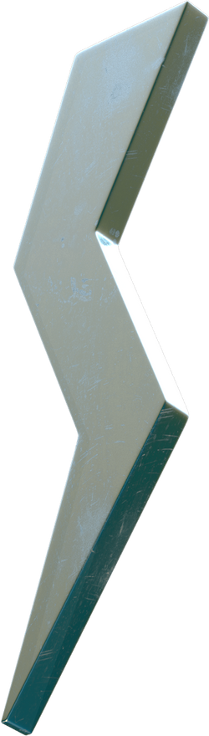
Agenda
Anaconda Installation
What are kernels and environments?
How to use Notebooks?
Numpy and its basic operations
PyTorch Basics
What you’ll know.

Slide 3
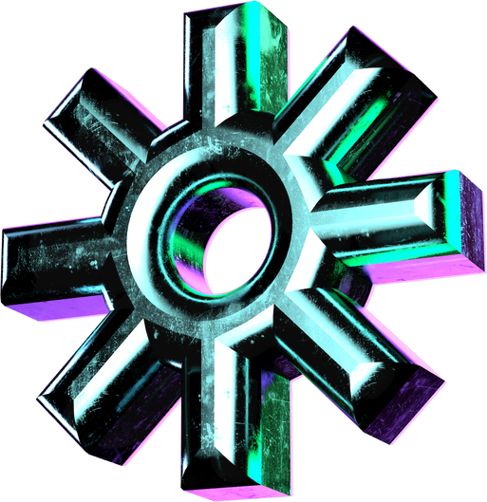
What is a kernel?
The kernel is the computational engine that executes the code contained in a notebook document.
It is responsible for executing the code in the notebook, performing calculations, and returning the output to the user interface.

Slide 4
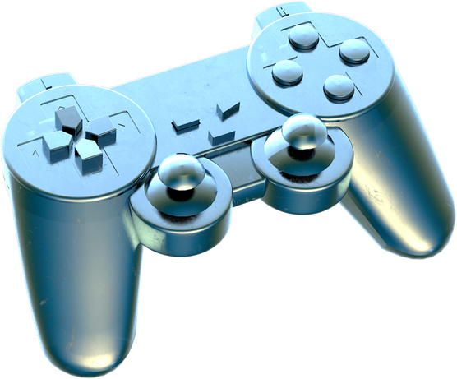
What is environment?
The environment refers to the specific software setup that includes libraries, packages, and dependencies required to execute code.
Environments are necessary for:
Isolation of dependencies
Version Control
Stability and Testing

Slide 5
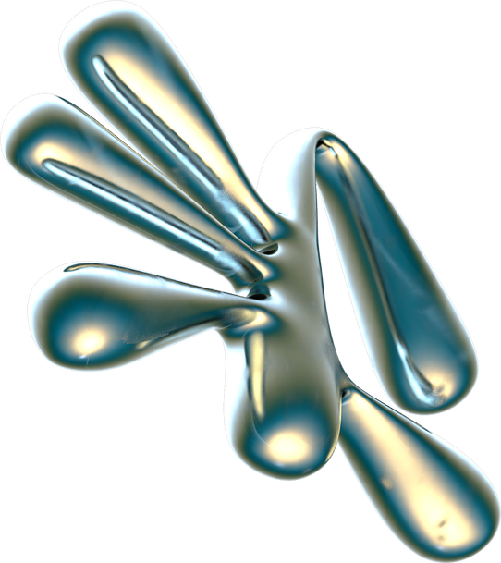
Notebooks

Slide 6
What are Notebooks?
Interactive documents that allow users to combine live code, visualizations, explanatory text, and multimedia elements in a single environment.
Why use Notebooks over scripts?
facilitates a step-by-step approach to problem-solving
allows for inline plotting of graphs and visualizations
can use markdown cells to add explanations or document your thought process

Slide 7
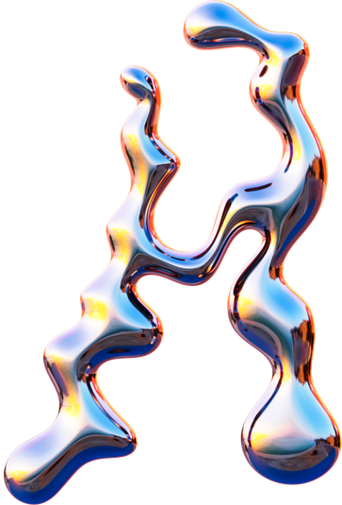
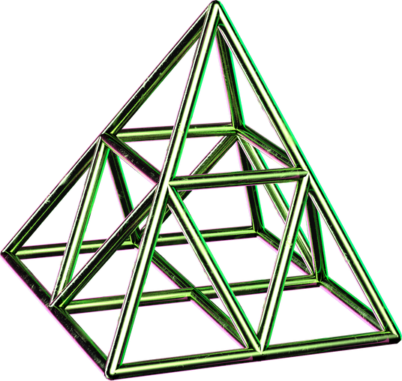
Linear Algebra with Numpy
Eigen values:
special set of scalars associated with the system of linear equations, mostly used in matrix equations.
Eigen vectors:
non-zero vectors that only change by a scalar factor when a linear transformation is applied to them.
Norm:
measure of the size or length of a vector in a vector space.
Determinant:
scalar value derived from the elements of a square matrix that provides important geometric and algebraic information

Slide 8
PyTorch

Slide 9
What is PyTorch?
PyTorch is an open-source machine learning library for Python which allows maximum flexibility and speed on scientific computing for deep learning. It is a replacement for NumPy to use the power of GPUs.

Slide 10
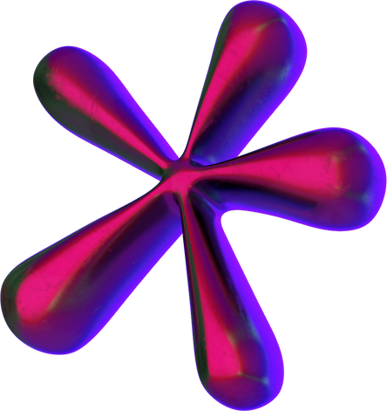
PyTorch for Neural Networks
Modules |  | Layers |  | Autograd System |  | Optimization |  | Device Compatibility
Every module in PyTorch subclasses the nn.Module A neural network is a module itself that consists of other modules (layers) |  | Neural networks comprise of layers that perform operations on data. torch.nn provides all the building blocks you need to build your own neural network |  | PyTorch’s modules are tightly integrated with autograd system. It allows for automatic differentiation and gradient computation, essential for training neural networks. |  | It provides various optimization algorithms like SGD, Adam, etc., which can be used to update the parameters of the model based on the computed gradients. |  | PyTorch models can be trained on different types of hardware accelerators like GPUs or MPS, if available

Slide 11

PyTorch Hardware Acceleration
1. Get PyTorch installed
2. Download CUDA and cuDNN for that version of PyTorch
3. Configure PyTorch for your GPU
Hardware acceleration in PyTorch, particularly through the use of GPUs, can significantly speed up the training and inference times of neural networks.
Speed up computation!

Slide 12
Thank you :)
We hope you learned something new.

